Slide 1
AUTOMATIC BEAM CONTROLLER AND DASH CAM
MAJOR PROJECT
BATCH NO. 07
GUIDE- Mr. V RAJ KUMAR (Assistant Professor, EECE)
A.K.SRAVANTH-121710408003
K.YOGEESWAR-121710408023
M.SHALINI-121710408028
S.BHARATH-121710408041

Slide 2
SUB CONTENTS
1)Dash Camera
2)Automatic beam Controller

Slide 3
Making DashCam Using Raspberry Pi zero

Slide 4
What we actually building is a system that can record video continuously.A Dashcam is just one application for this and the entire process is divided into several modules.

Slide 5
Video Recording Section
This involves :
1.Capturing video from the PI camera
2.Storing it to the microSD card
3.This also involves Ensuring correct file numbering/naming
4.Detecting Remaining Storage.
5.And using FTP such as winSCP software to obtain video files

Slide 6
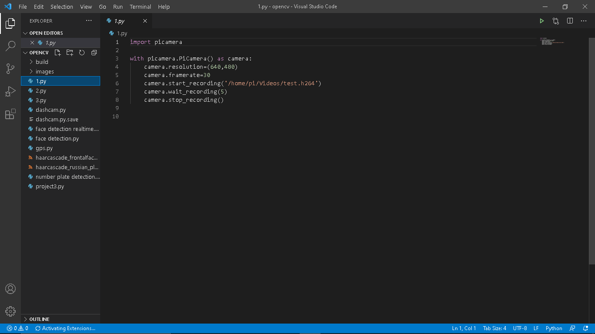

Slide 7


Slide 8
File Creation
Newest file number is stored in configuration file
Number of files that can be created is limited to 999.
Config file is automatically loaded when script is run
If it doesn’t exist then creates it and starts from 0
It also checks and creates the “videos”folder,if needed.
This eliminates the need to manually create any files or folders .

Slide 9
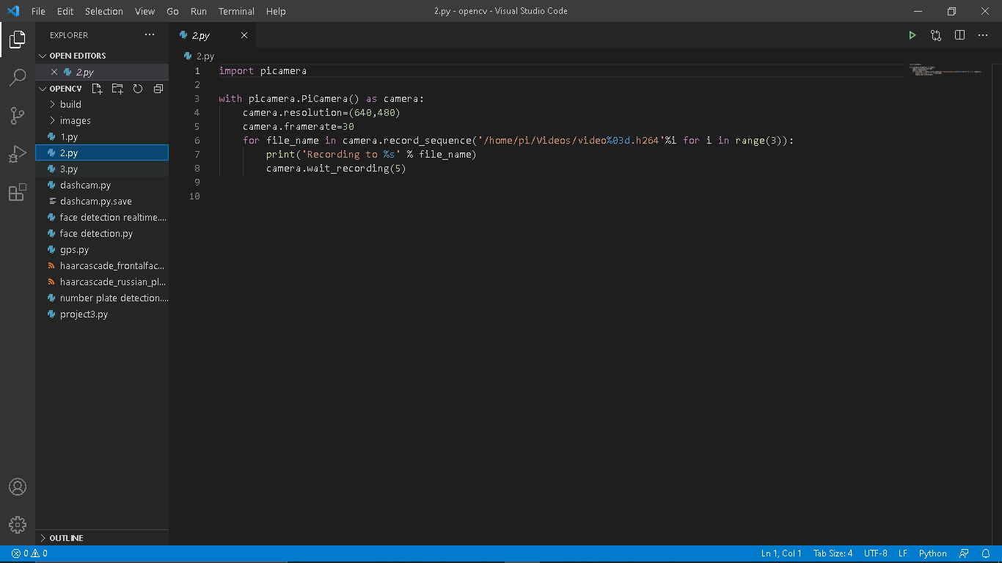

Slide 11
Handling of low memory condition
This need to be done when memory card is low on space
This threshold is determined by “SPACE_LIMIT”
If more than SPACE_LIMIT is used,then we initiate file deletion
Deletion sequence :
-Create file names starting from 0
-Check if file exists,if yes,then delete it,else try next one
-Repeat this for 10 files

Slide 12
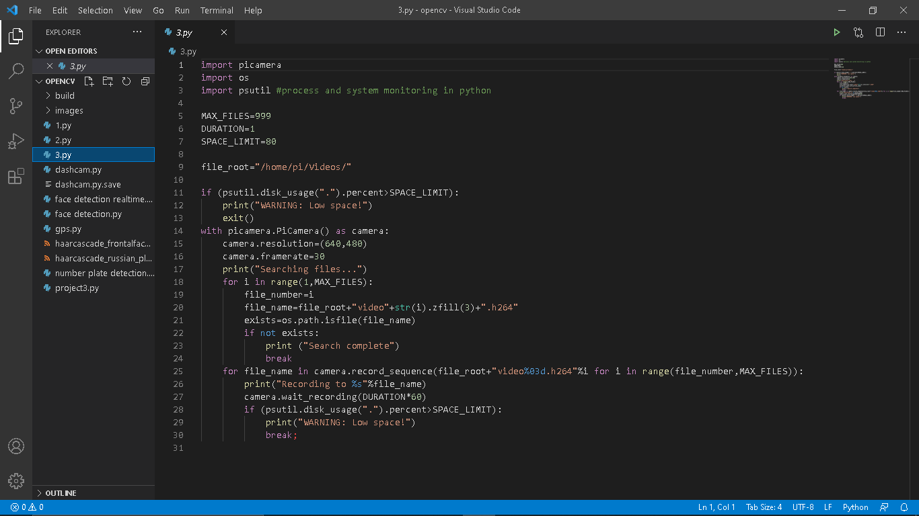

Slide 14
Overlay Module
Things like date,time for reference
GPS Module To obtain location along with the above
System parameters like CPU usage
We will then try to make it a bit easier to access the video files by using web browser.we will also add safe shutdown feature that will end with some sort of battery and finally we will automate everything add a case and carry out some road tests.

Slide 15
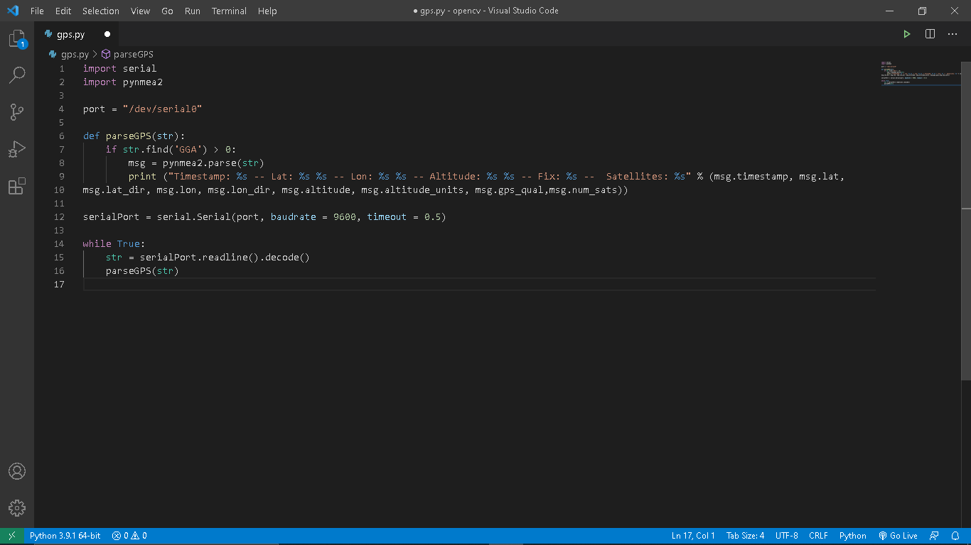

Slide 17
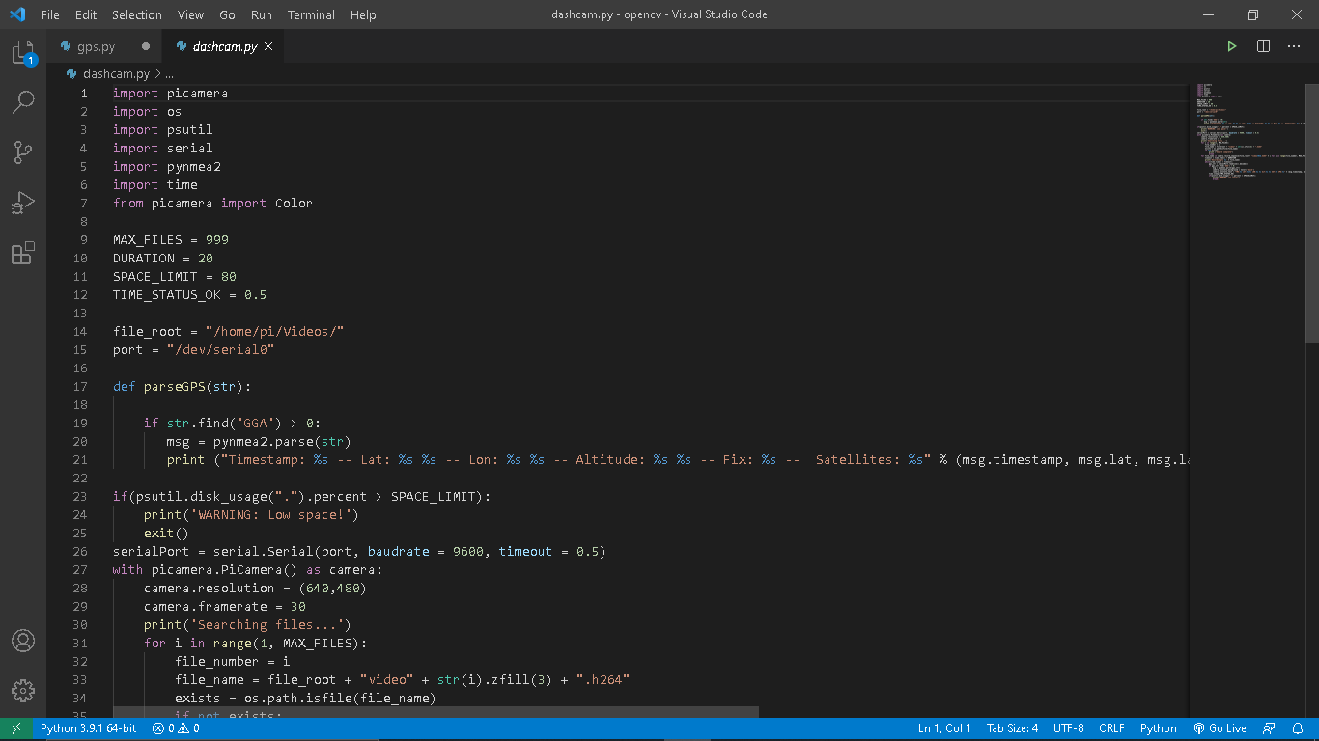

Slide 18
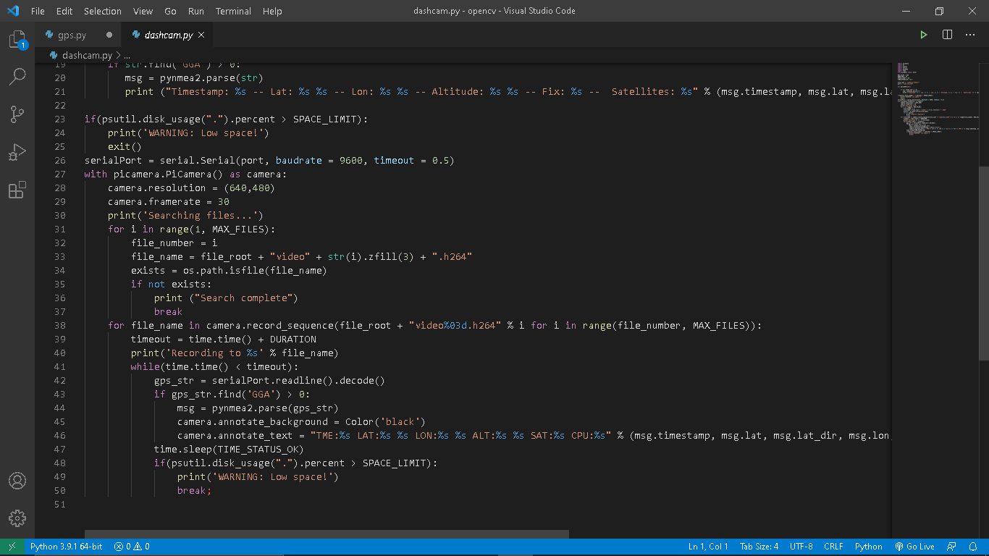

Slide 20
Misc.Features
Status LED to indicate script activity while recording
Blinks while video is being recorded,rate depends on GPS data
If it stops blinking,then script has probably encountered an issue
RPi needs to be shutdown safely and not abruptly
External switch can be used to manually shutdown.

Slide 21
Automatic beam Controller

Slide 22
FEATURES
This involves :
1.Automatically detecting vehicles using haarcascade.
2.Drawing a rectangle around the target(Number Plate)
3.Switching mechanism when it detects any vehicle using relay module and a bulb.

Slide 23
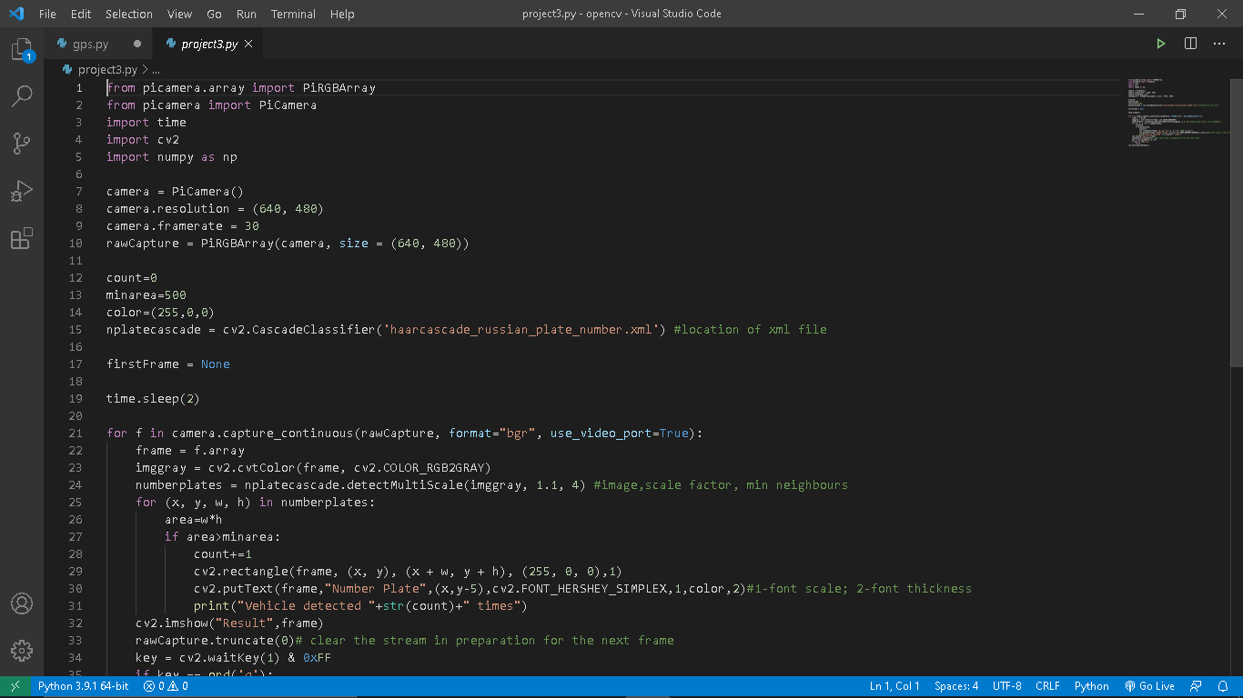

Slide 24
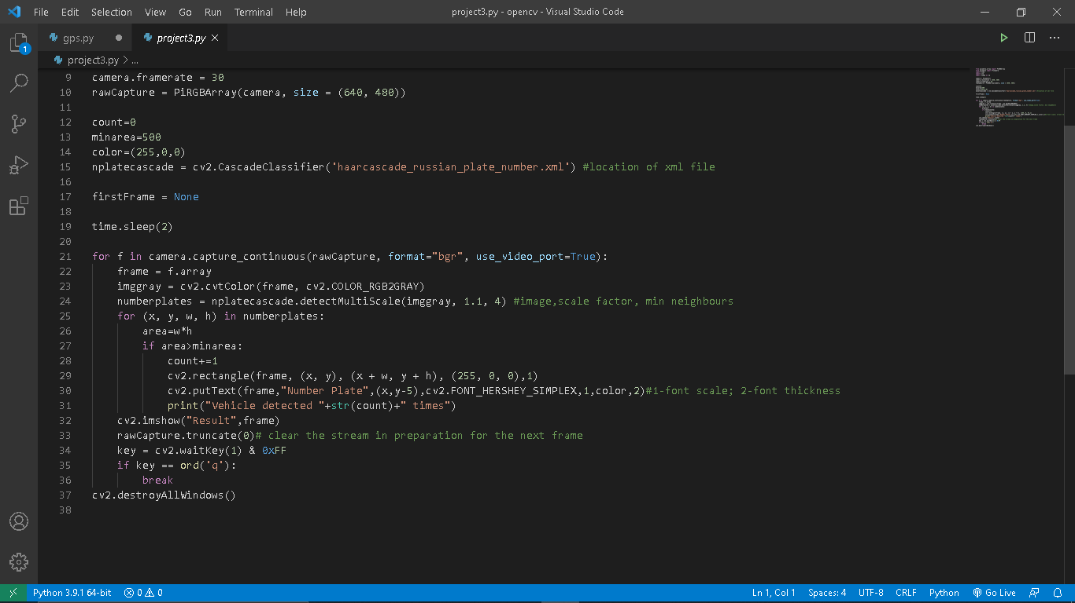

Slide 27
THANK YOU

